Slide 1
Model-based Integrated Planning and Control of Autonomous Vehicles using Artificial Potential Fields with uncertain environment
Emilio Benenati
Josyula Viswanath Das
23rd November 2021

Slide 2
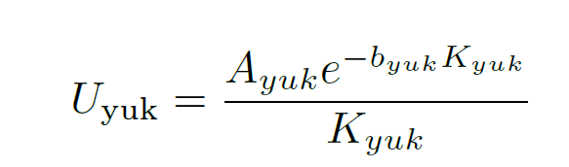
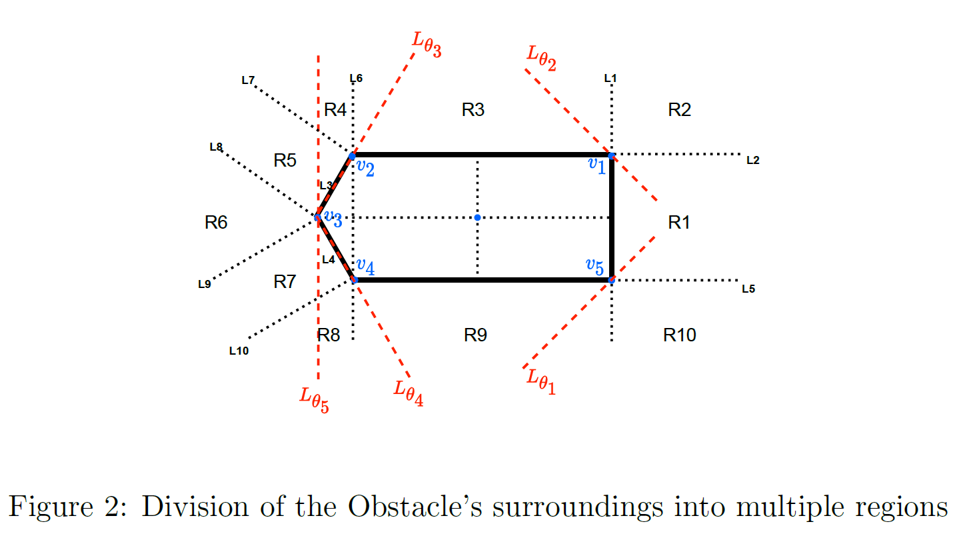

Slide 3
Answers
Q. What is represented in Figure 5 and why does the potential not go to infinity?
Ans. The whole potential including all the region is represented in Figure 5. It does not go to infinity as I selected the value of A_{yuk} and b_{yuk} so that the value is low. The maximum value of the cost was also restricted to get a better understanding of what is going on.
Why are the borders of the light blue region outside?
Ans. As the surface plot used to show the surface of the potential is dependent on the number of (x,y) coordinates you have the value of the potential at (the z coordinate), having a small number of (x,y) makes it look so. Having a higher resolution will make it look better but this will not be a problem when implementing it along with the MPC.

Slide 4
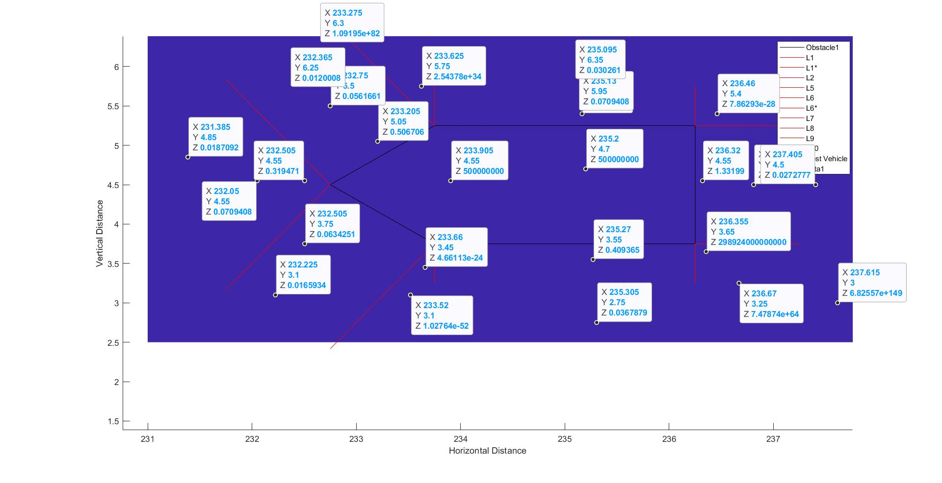
When the Obstacle is Plotted as a whole and the height is not restricted

Slide 5
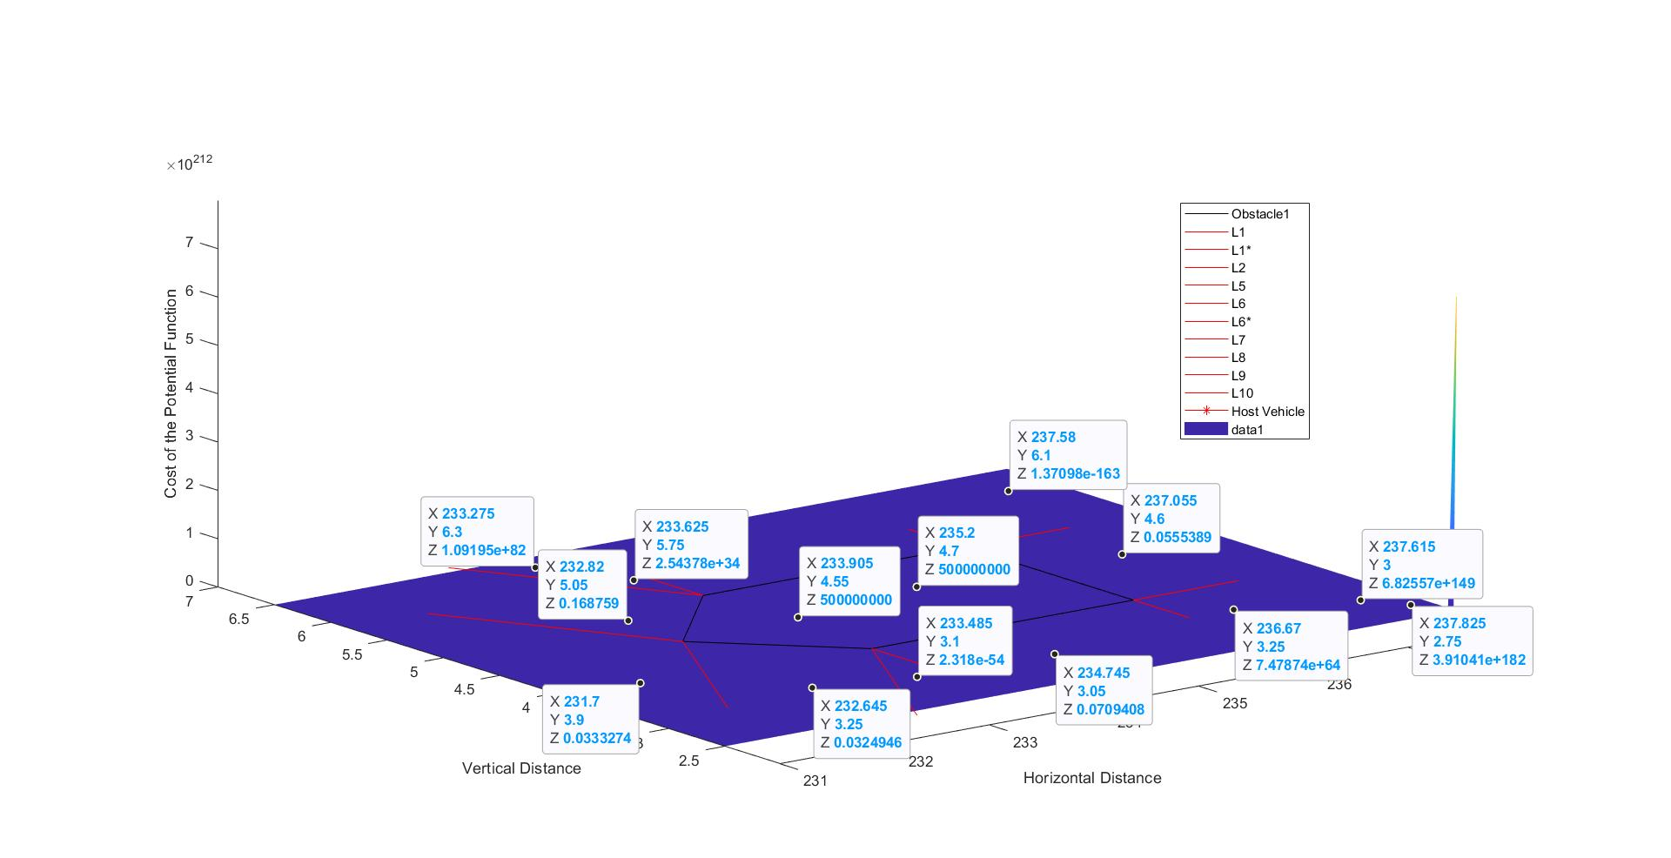
When the Obstacle is Plotted as a whole and the height is not restricted

Slide 6
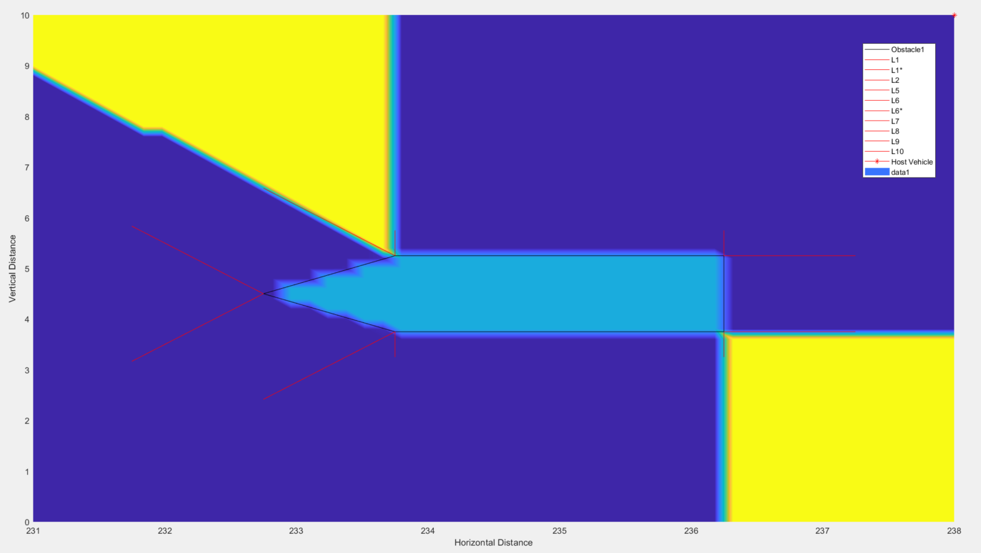
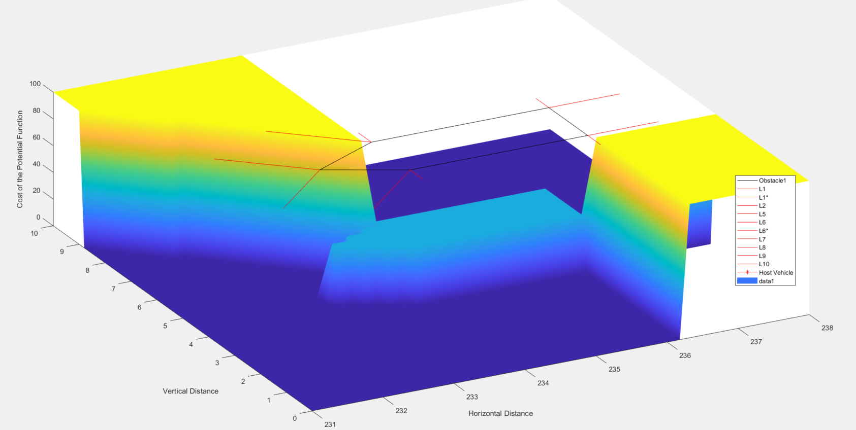
When the Obstacle is Plotted as a whole and the height is restricted

Slide 7
Answers
Q. What does figure 6 and 7 represent?
Ans. This represents the first order approximation of the potential function in regions 2 and 10 respectively. It was drawn by taking a constant value of the y coordinate and hence can be represented in 2 dimensions. The scale of one of them is very large as the value (as seen in slide 5 and 6) is very large in itself.
Q. About the reliability of the symbolic toolbox? Cannot answer. Have to check.
Q. About the convexity of the function. I was talking about the taylor series approximation.

Slide 8
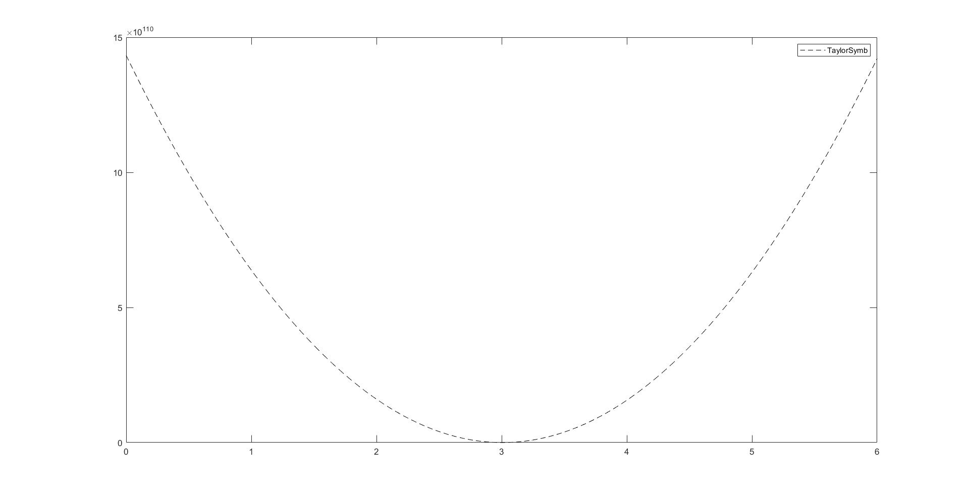
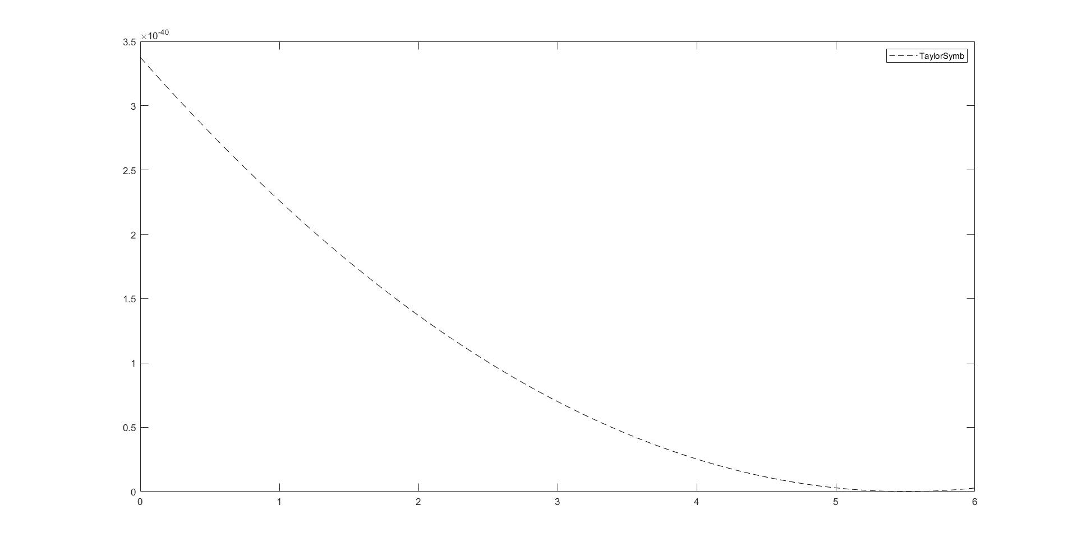

Slide 10
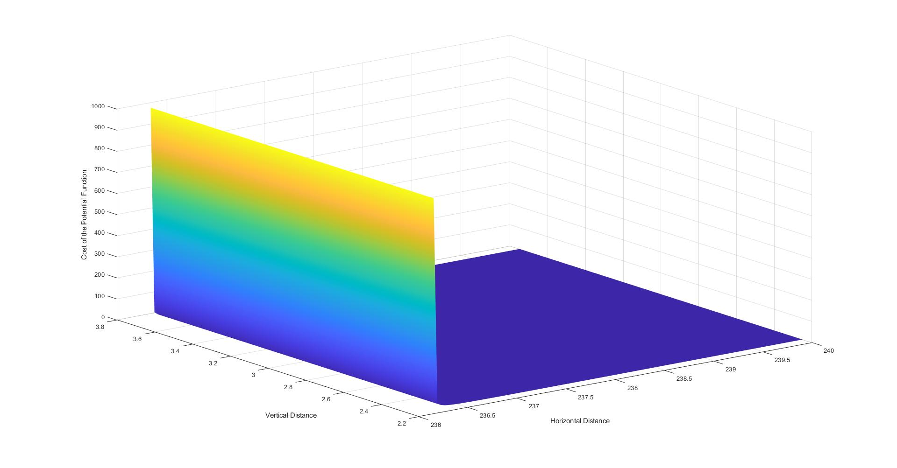
Region 1

Slide 11
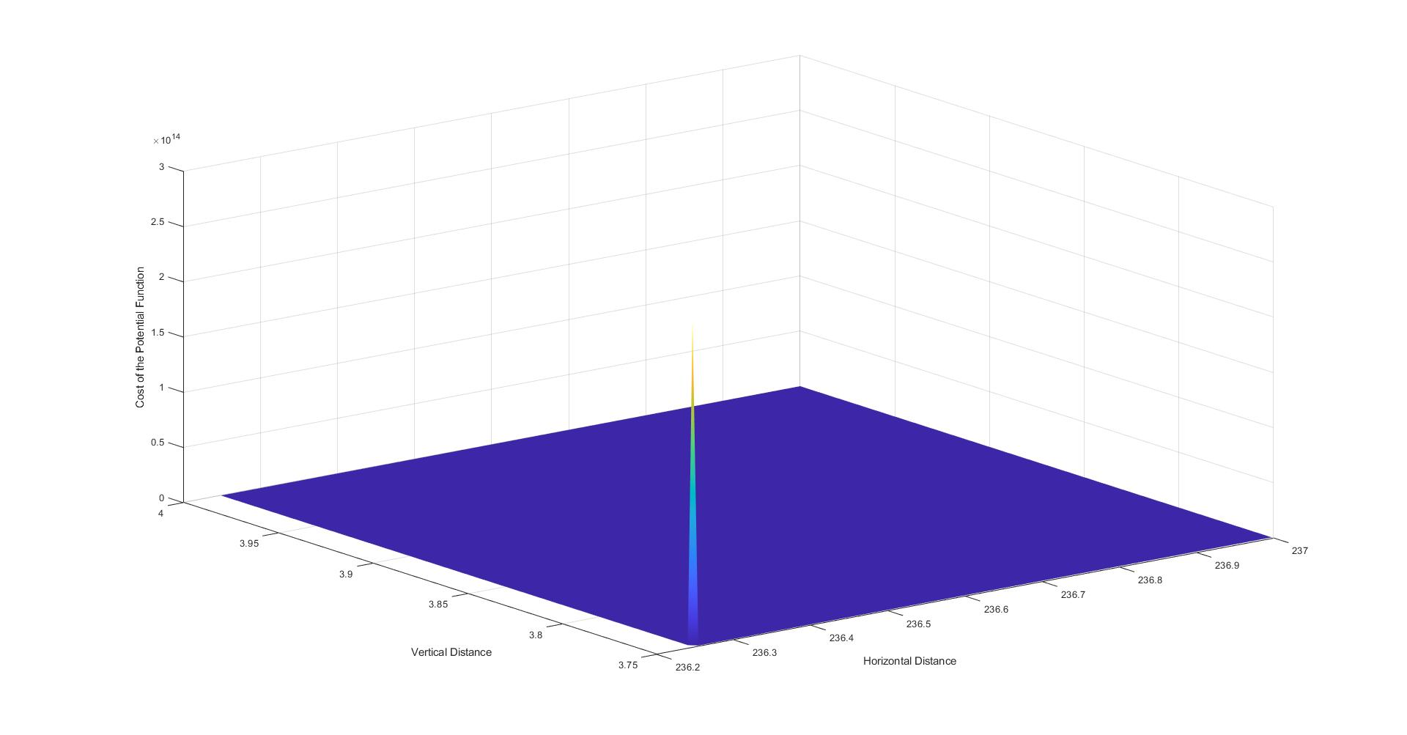
Region 2

Slide 12
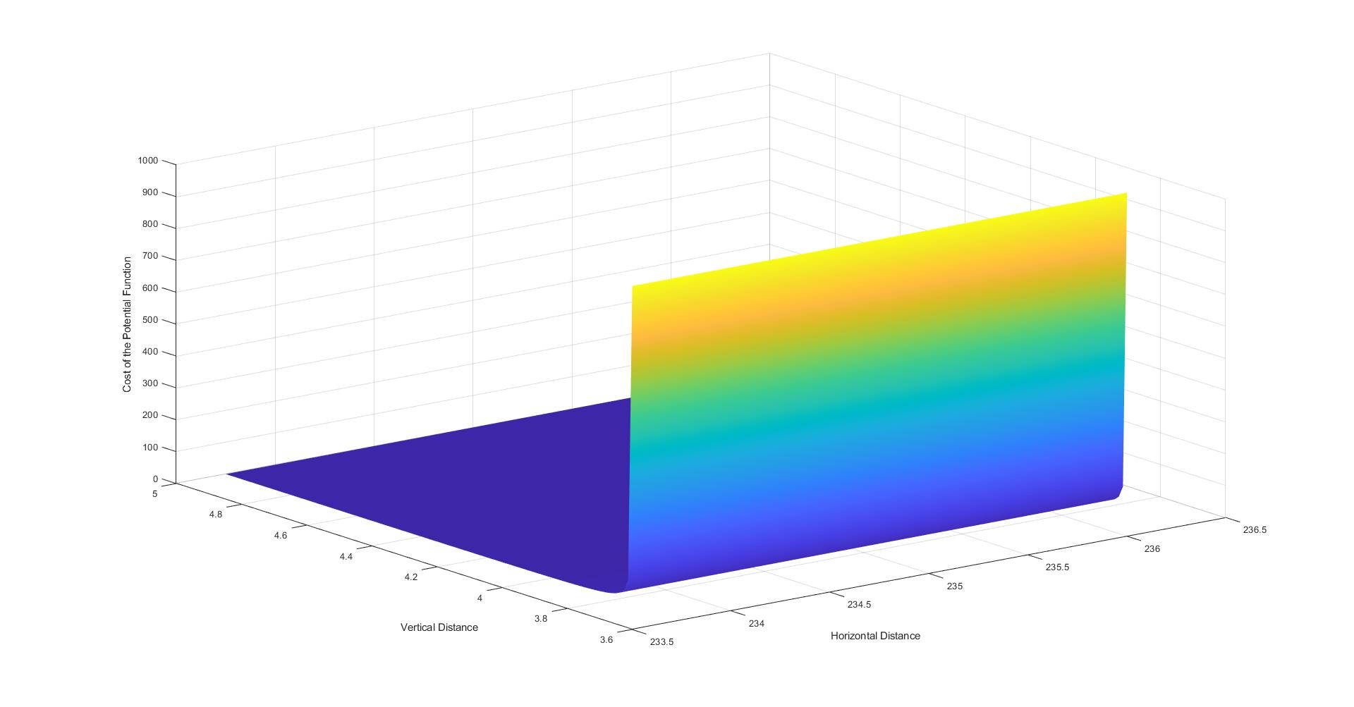
Region 3

Slide 13
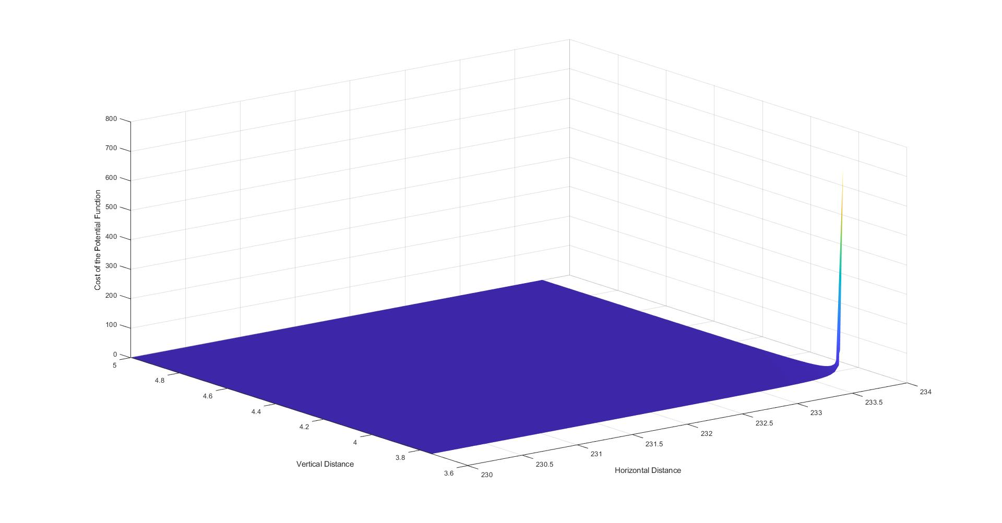
Region 4

Slide 14
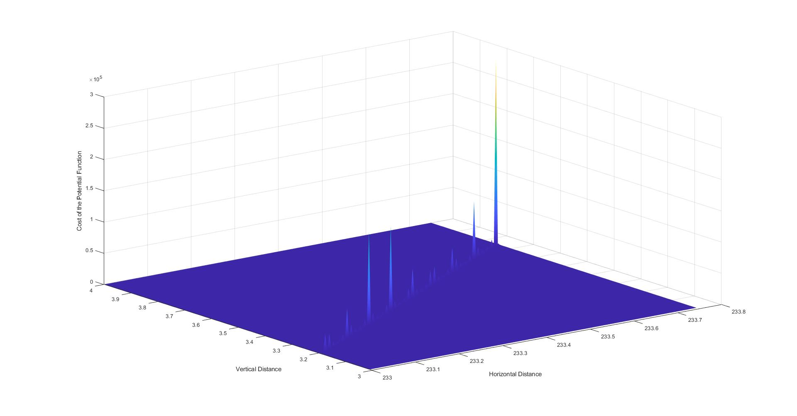
Region 5

Slide 15
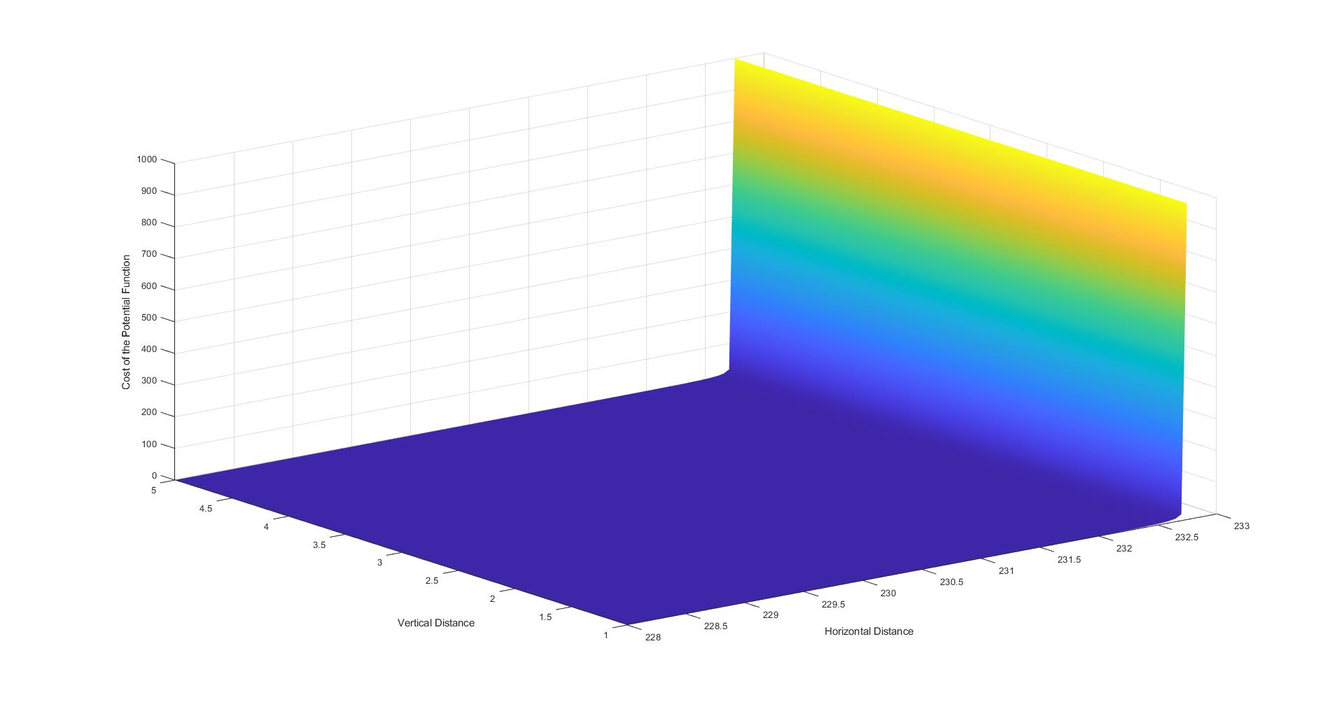
Region 6

Slide 16
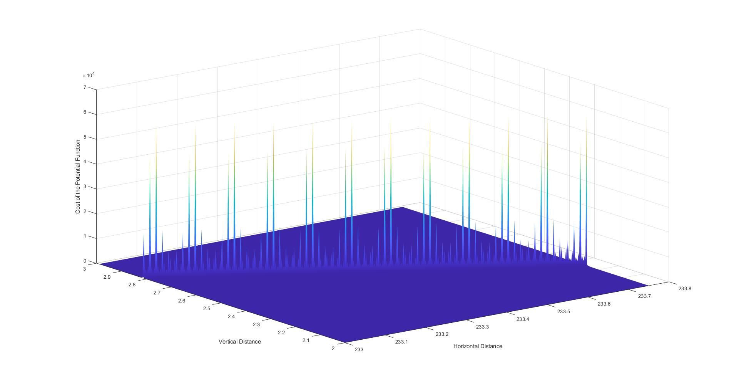
Region 7

Slide 17
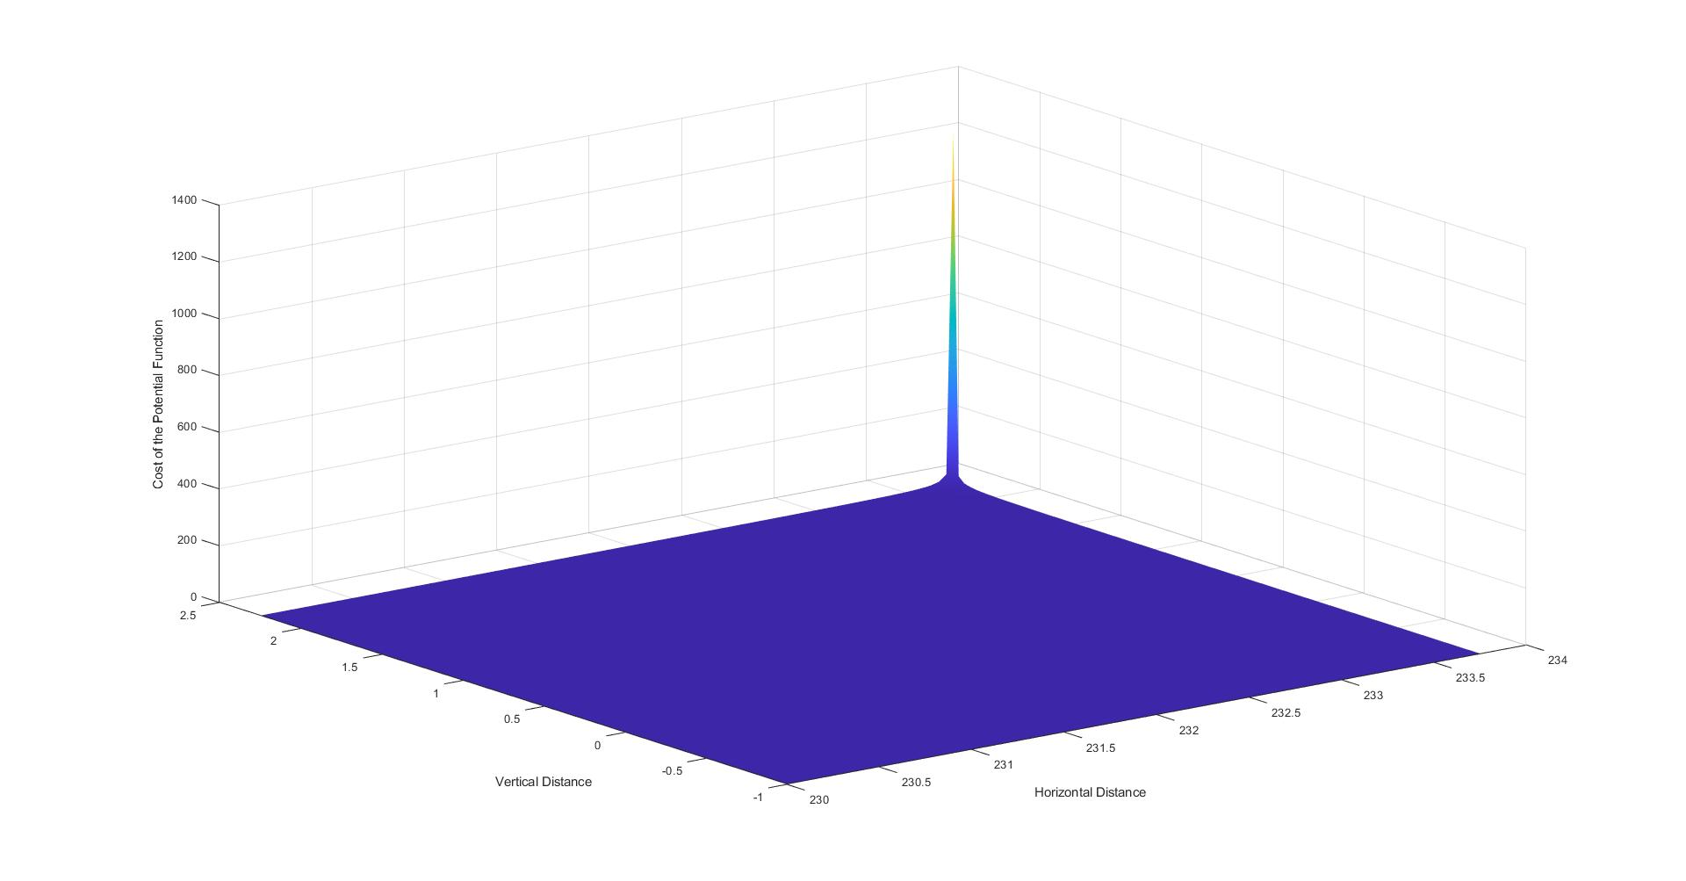
Region 8

Slide 18
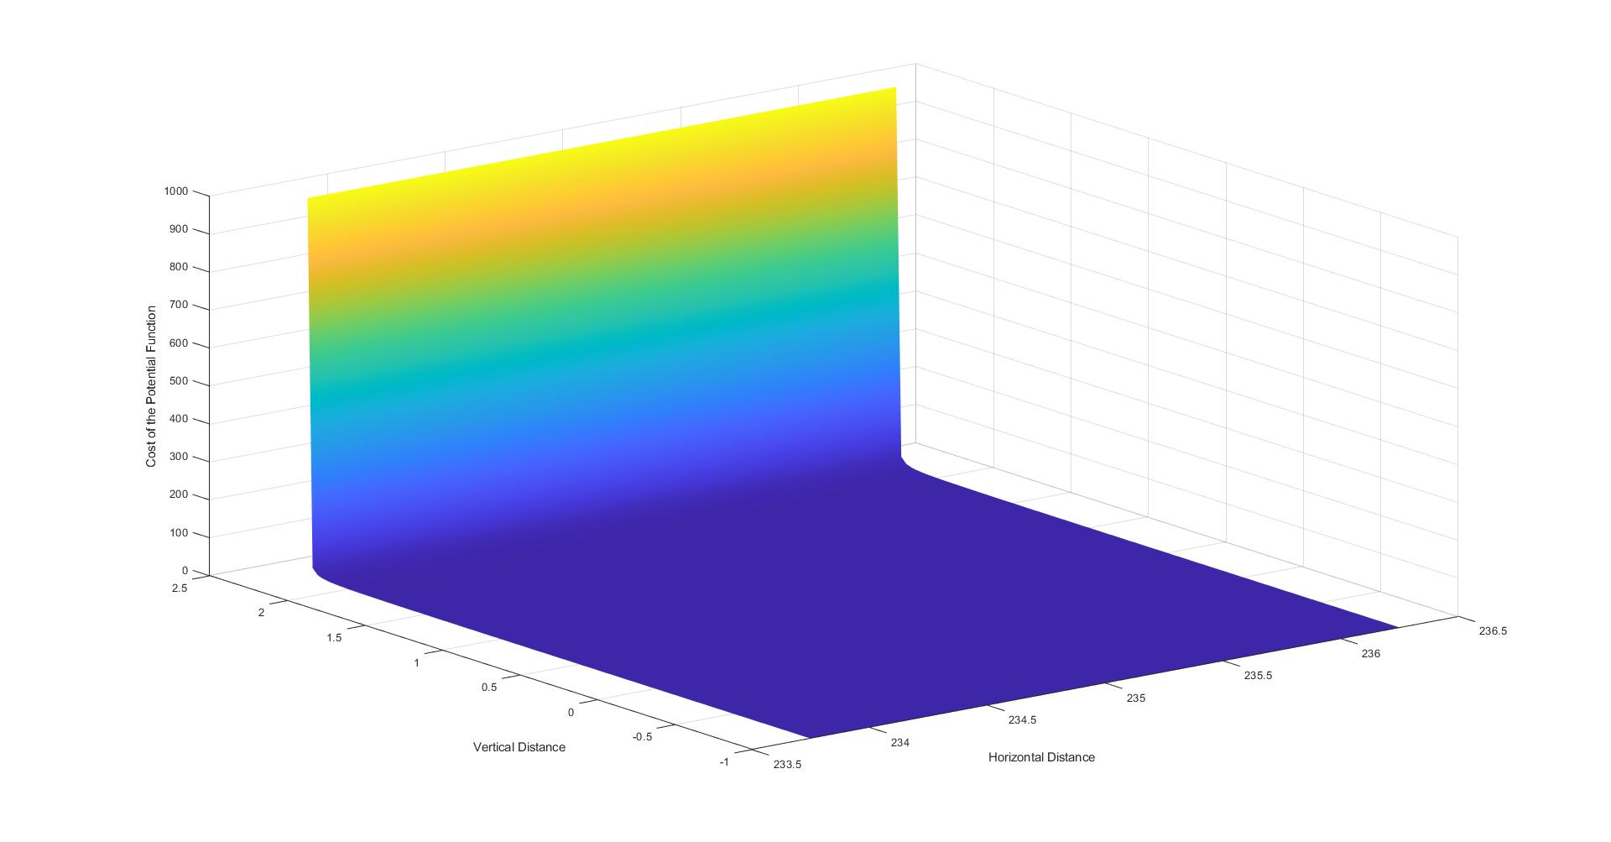
Region 9

Slide 19
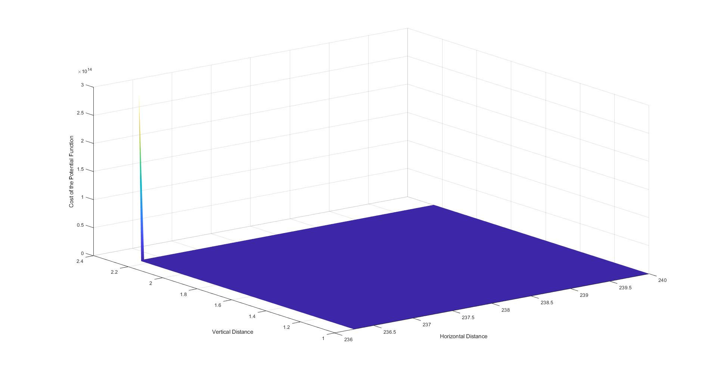
Region 10

Slide 20
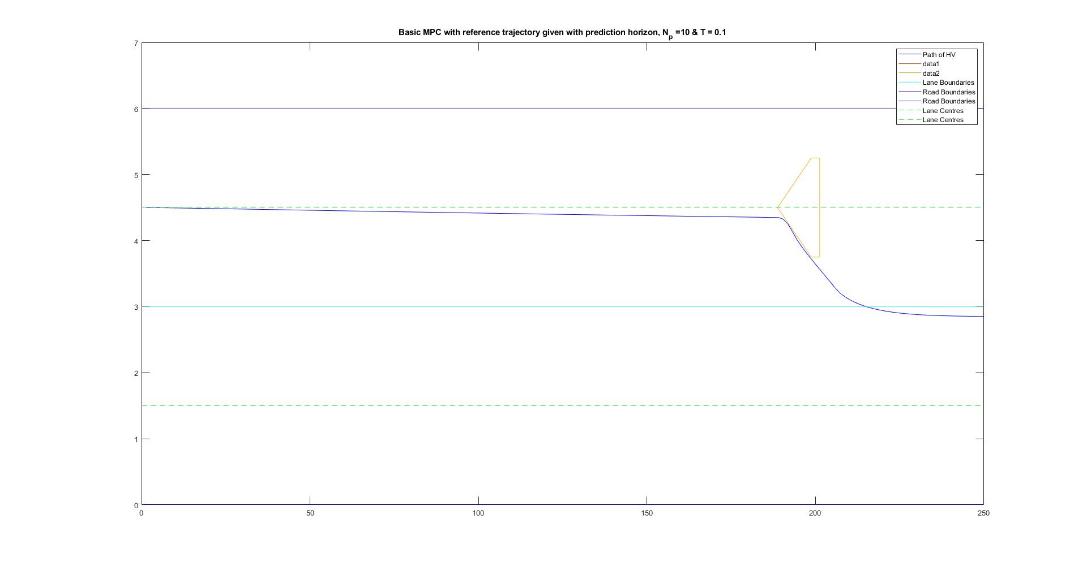
Path Travelled by the Host Vehicle

